Slide 1
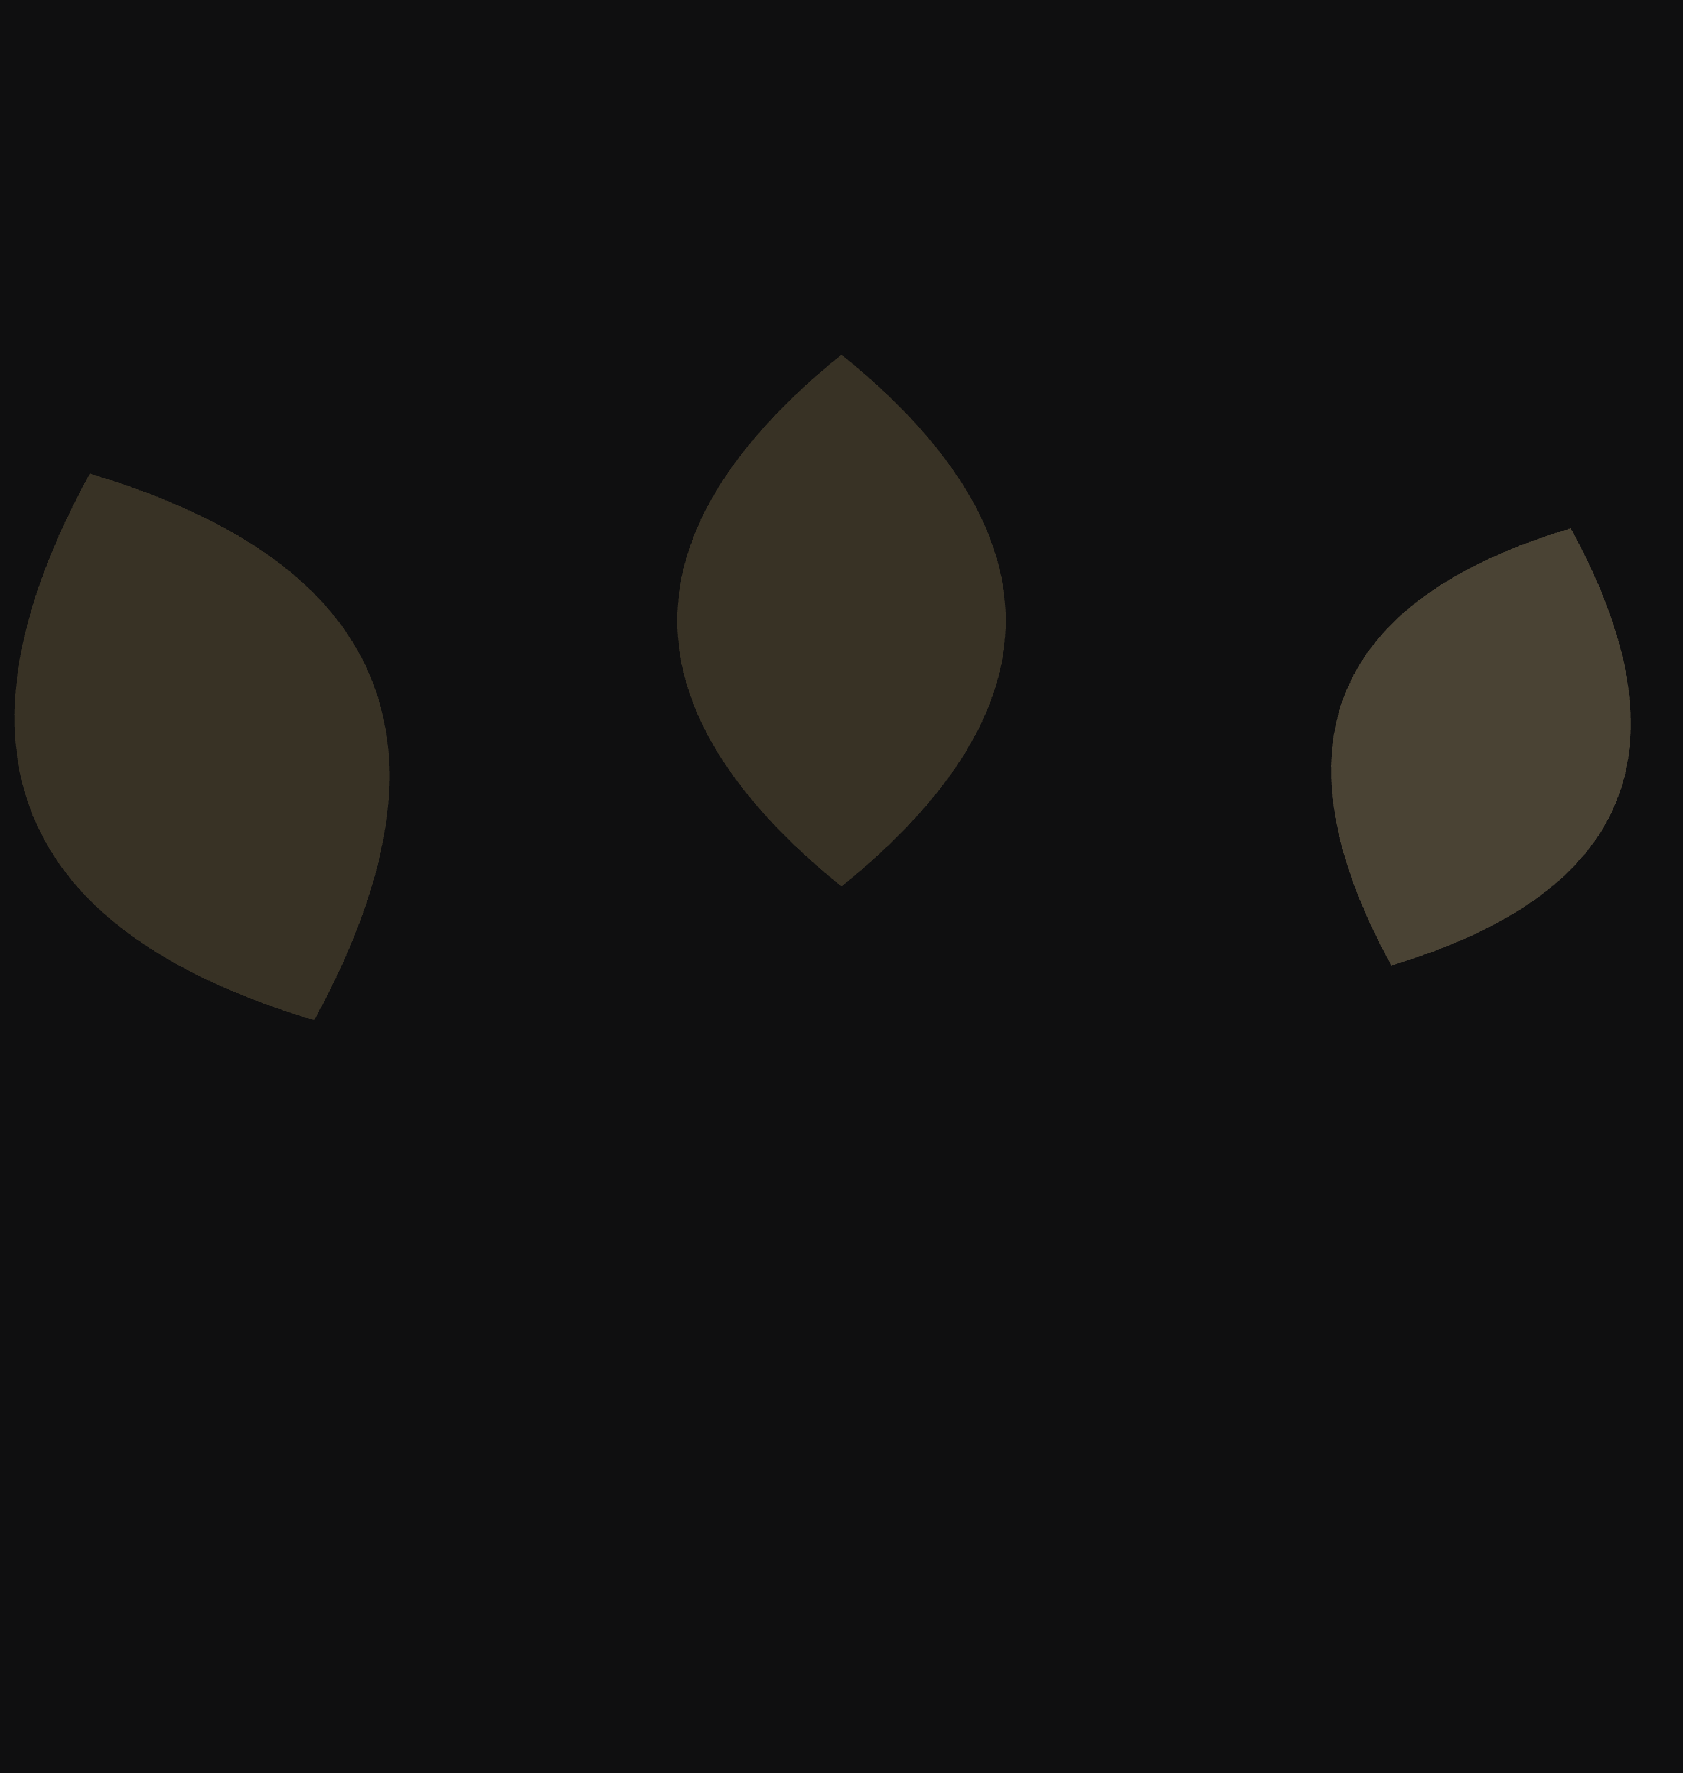
A TEST · NOT A RULING
The pattern was the
problem. Not the shape.
The first pass tessellated. Every shape touched another shape, the field filled edge to edge, and the eye had nowhere to rest — which is what suffocating means. This pass takes its instruction from how Anthropic works a field: very few forms, one hue in tonal steps, one form far larger than the others, shapes that run off the edge, and a great deal of air.
Five fields. One law.

Slide 2
Five Points Digital Studio
The field
2026
pg 2
The law of
the field
Five rules. They are what separates a field from wallpaper, and they are the reason the first pass failed. Every one of them is a rule about restraint.
01
02
03
04
05
Few elements
One hue, several steps
One form dominates
Shapes leave the frame
Nothing repeats
Three to six forms in a field. Never more. What is not there is the composition.
A field is a single colour rendered in three or four tonal steps. Never a mix of the five voices.
One shape is far larger than the rest. Forms at equal size read as wallpaper, whatever the spacing.
At least one form is cut by an edge. A field that fits neatly inside its box is a picture, not a field.
No tile, no tessellation, no grid. The eye must never find the seam. Every field is issued once.
What the law forbids: a field behind body copy at full strength, more than one field on a spread, the mark rotated, and the complete mark used as a pattern element. The mark is the mark. The pieces are the pattern.

Slide 3
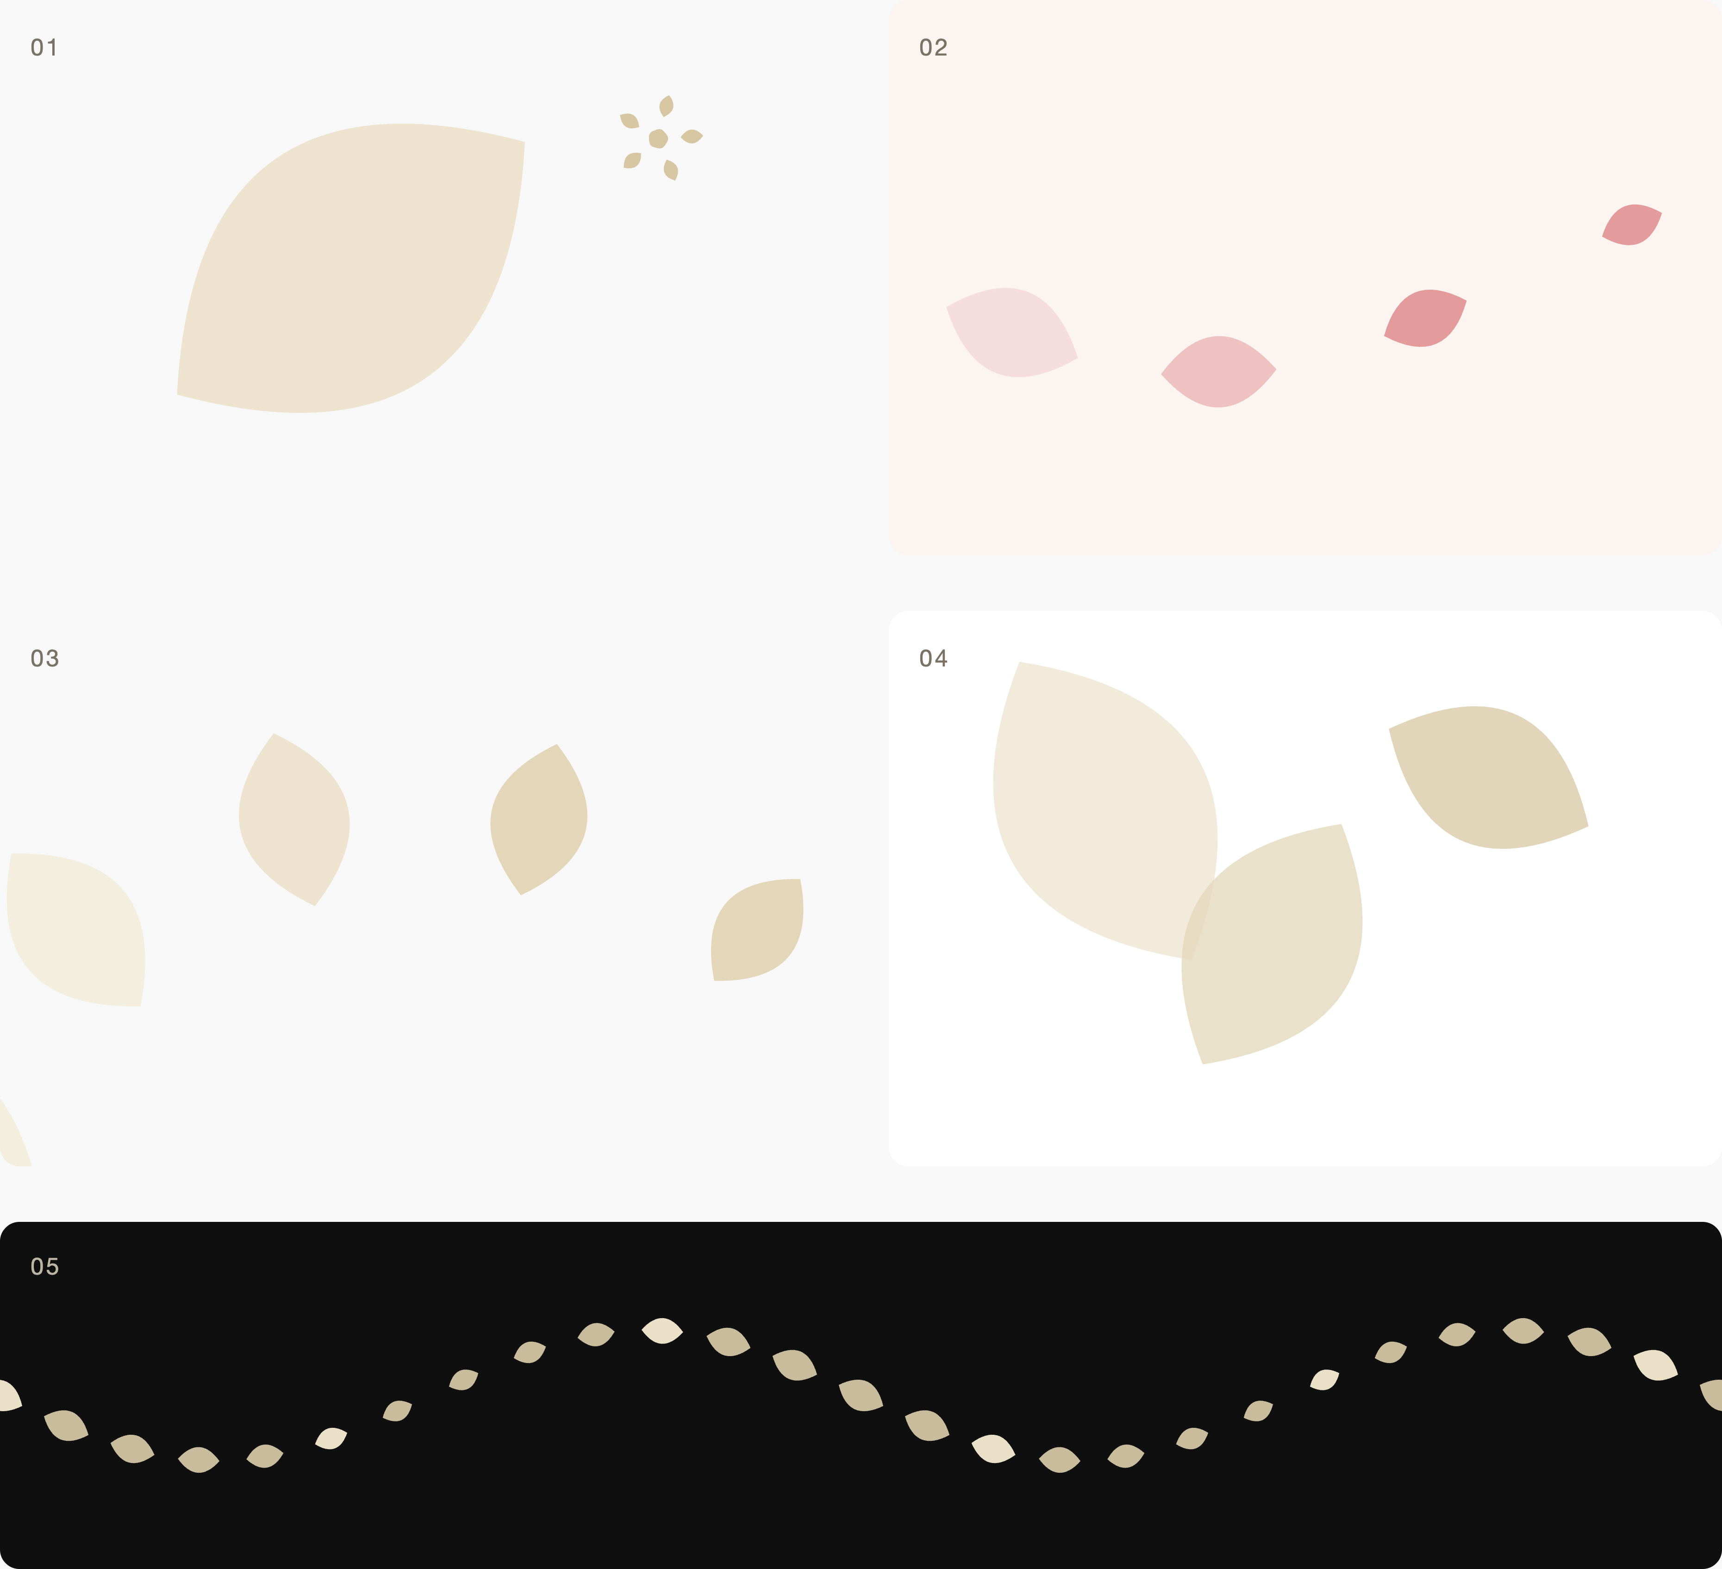
Five Points Digital Studio
The field
2026
pg 3
Five fields
One kit, drawn entirely from the leaf and the mote. No new shapes were invented to make it.
01
The Crop
One leaf at scale, the mark as counterpoint. Covers, section fronts, anything large.
02
The Drift
Leaves carried on a current, large to small. Card backs, notes, email headers.
03
The Arc
A sweep round a pivot outside the frame. The dynamic field: openers and dark registers.
04
The Overlap
Three petals, two crossings. The crossings make a fourth tone. Pull pages and quotes.
05
The Rule
The mote band, undulating. Dividers, footers, spines, the band between sections.

Slide 4
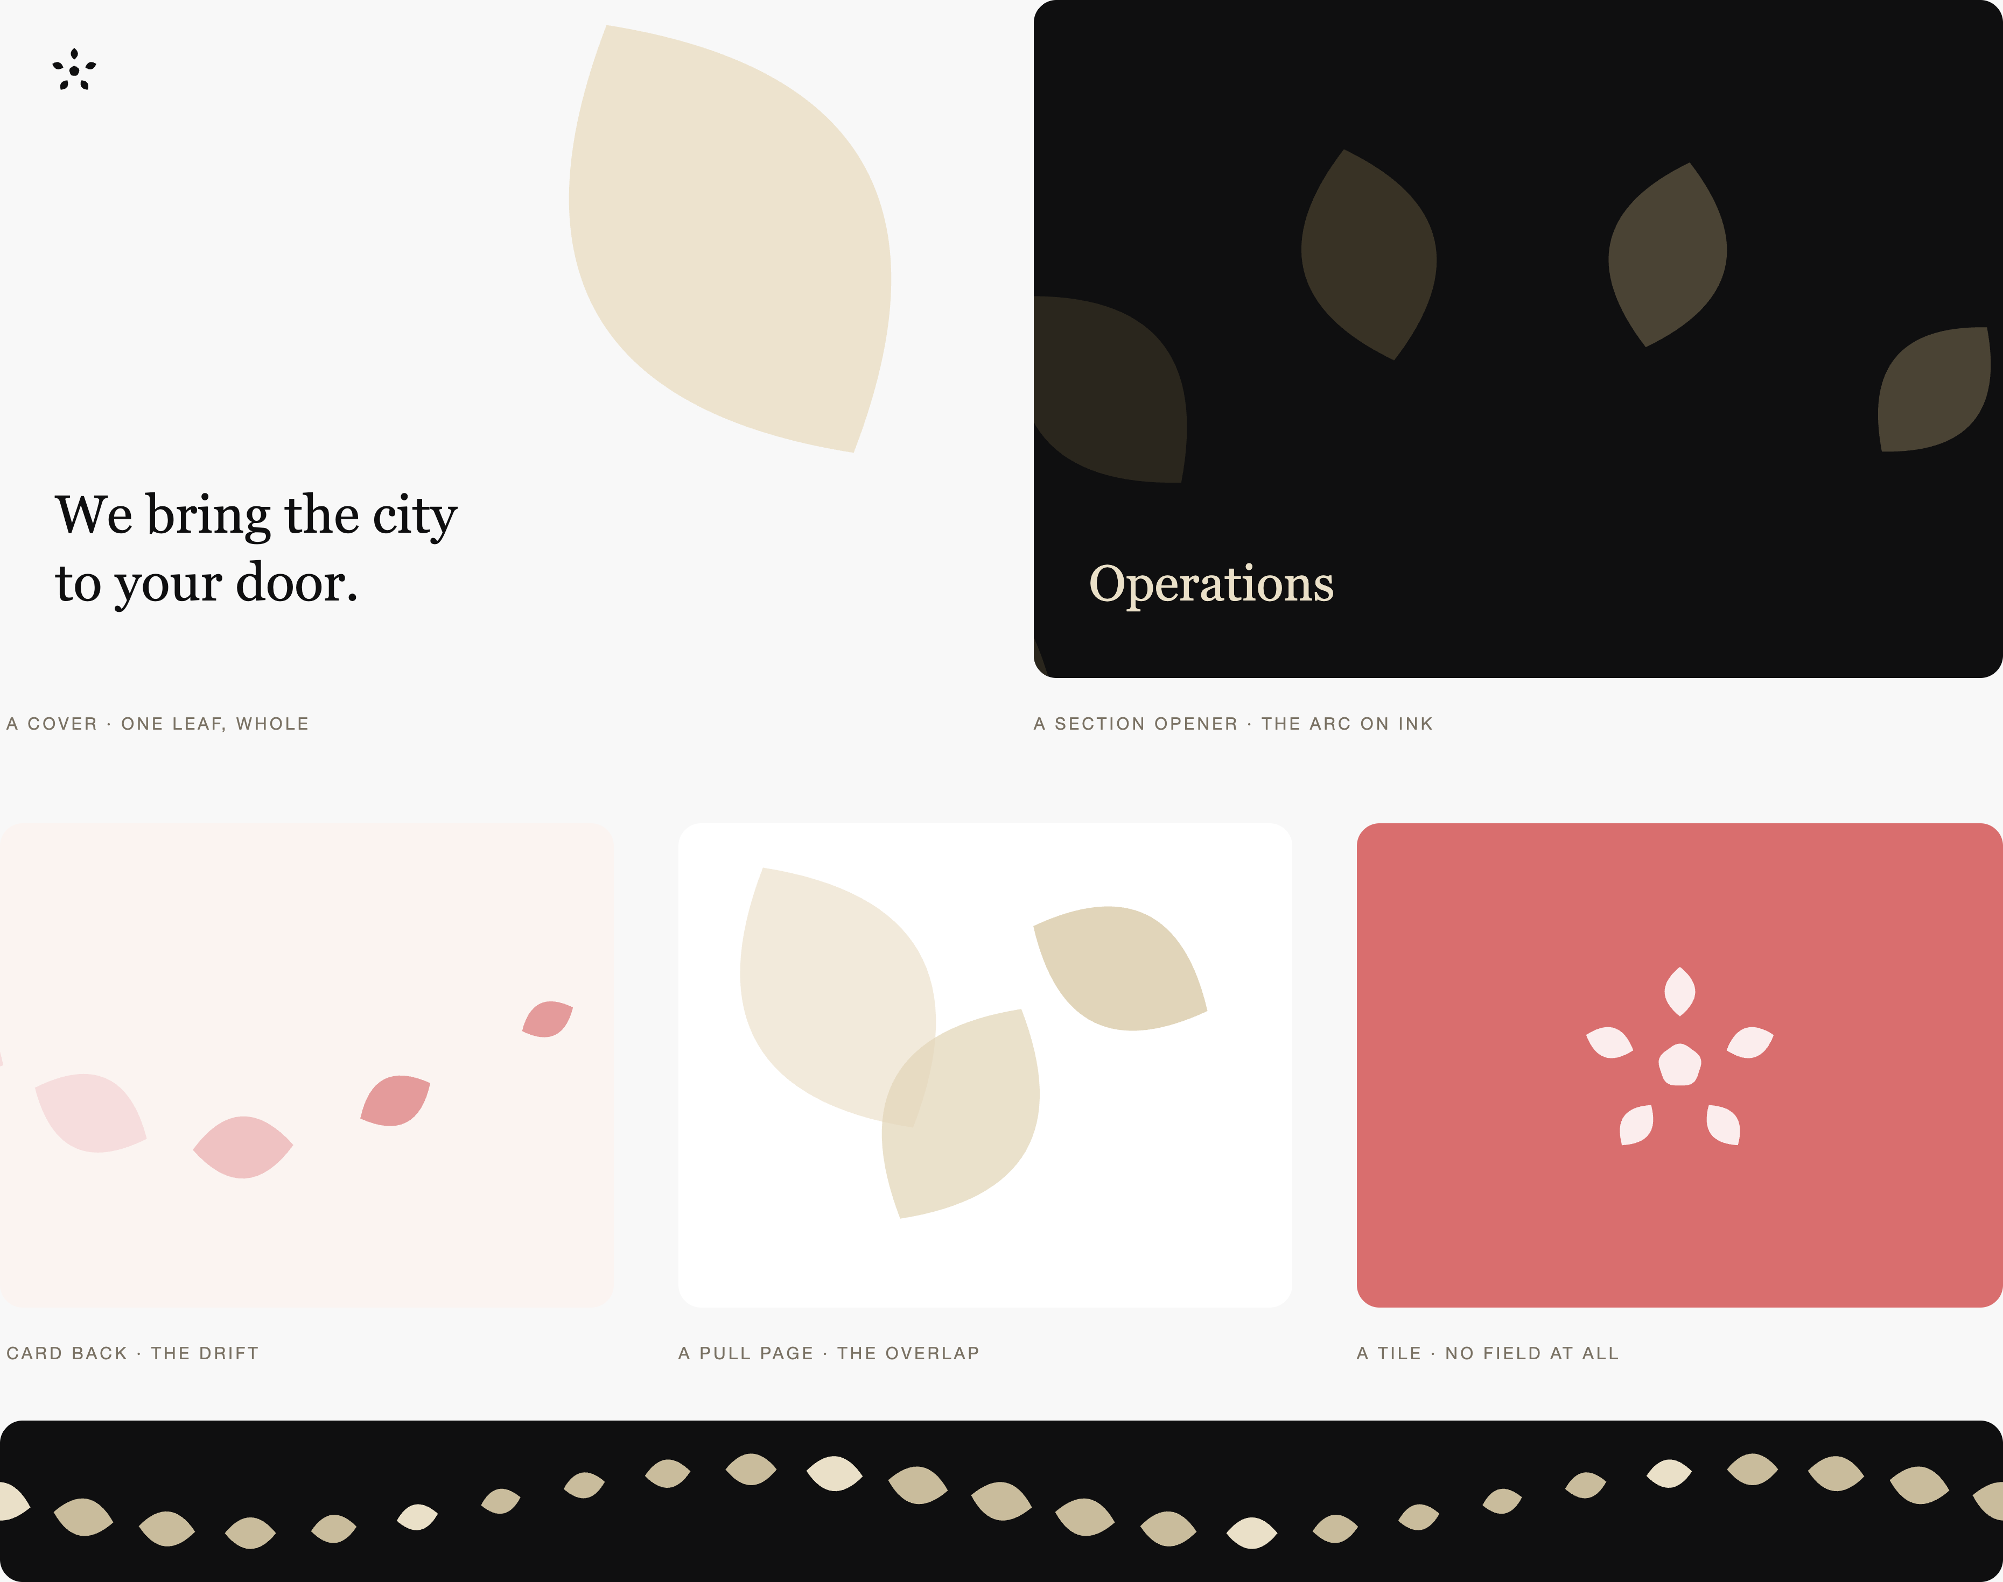
Five Points Digital Studio
The field
2026
pg 4
In use
The field is never the subject. It is the air the type sits in, and on the surfaces that carry no type it is the whole surface.
Note the tile at the far right: no field at all, the mark alone on a voice. That is not an omission. A system that cannot hold silence has no dynamics, and every surface begins to shout.
Note also the divider. It is the same mote at the same spacing law as the field above it, which is what makes a kit a system rather than five separate ideas.

Slide 5
Five Points Digital Studio
The field
2026
pg 5
What I
would rule
Three decisions sit here. The first two are mine to recommend. The third is yours alone, and it has been open since the rosette test.
Adopt the five
Hold the Arc back
The mark itself
The kit as drawn, with the law of the field written into the fingerprint at Layer 2.
It costs nothing that is currently in use — there is no pattern system to retire — and it gives the brand a texture layer it has never had.
Recommended.
The Arc is the most dynamic of the five and the easiest to overuse.
I would reserve it for section openers and the dark register only, and keep the Crop and the Drift as the everyday fields.
A restriction is easier to relax later than a habit is to break.
Still open from the rosette test: crystal, rosette, or both.
This kit works under either. The pieces come from the leaf and the mote, which both marks share.
My recommendation stands — the crystal ceremonial and large only, the rosette on every working surface — but it wants a trademark knockout before it is written down.
Nothing in this document has been applied to the fingerprint, the design system or the site. It sits in the renovation ledger with the rest, pending a closing pass.

